Slide 1
Machine Learning for Mere Mortals
Dev Nambi
Data Geek
University of Washington
@DevNambi
me@devnambi.com
Notes:
Message:
Story To Tell:

Slide 2
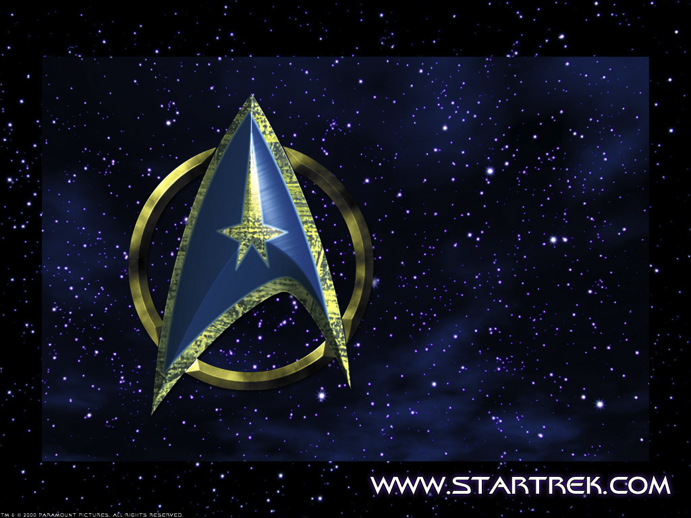

Slide 3
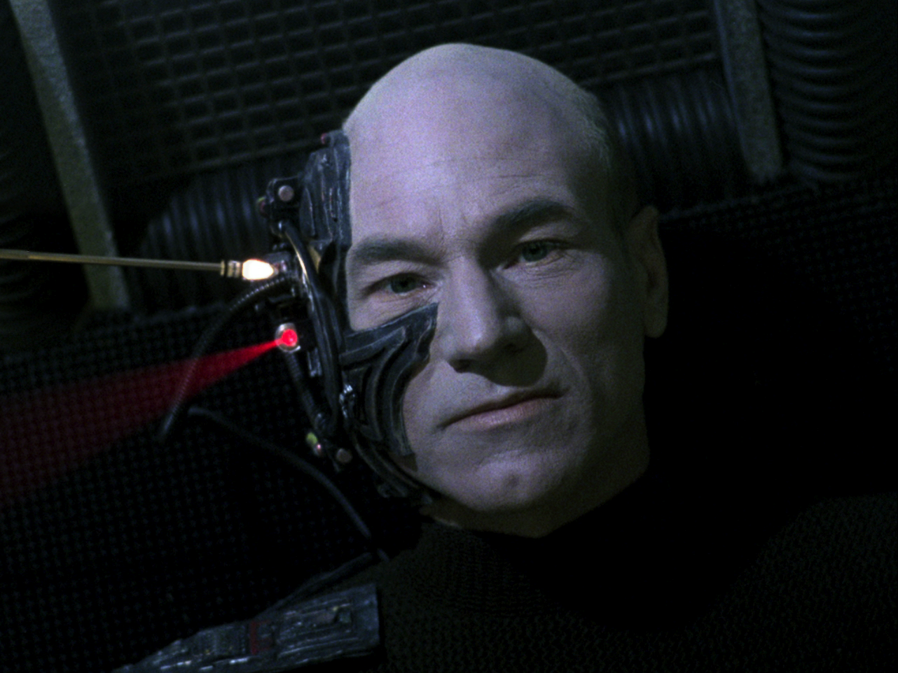
Resistance is Futile
Notes:
Message:
Story To Tell:
It’s everywhere:
Amazon recommendations
Google Search, Images, Translate
Facebook (‘People You May Know’)
Netflix recommendations
Email (spam filter)
Banks (fraud detection)
Science (image analysis, weather forecasting)
Retailers (product placement)
NSA (network analysis, identifying suspicious communication)

Slide 4
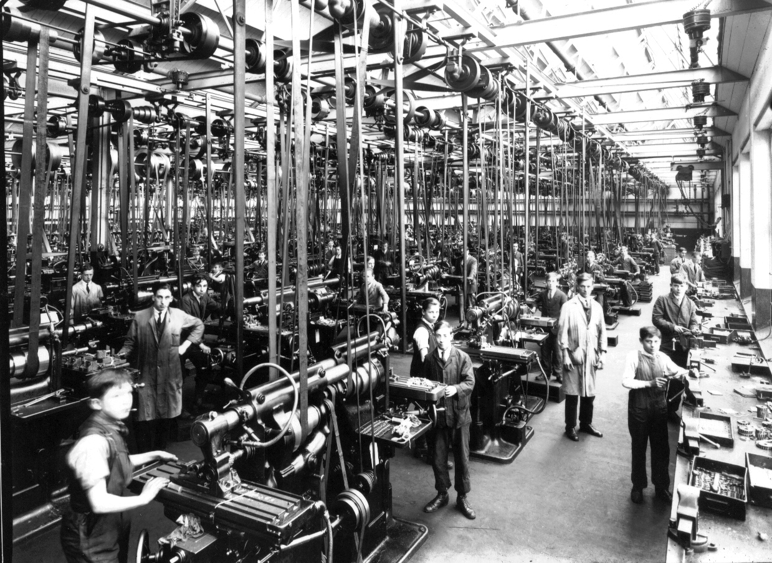
What’s with this newfangled machine learning, anyways?
Notes:
Message:
Story To Tell:
Why Does it Exist:
You don't write the rules. You write the math. The data informs the math to create the rules
"How can we build computer systems that automatically improve with experience, and what are the fundamental laws that govern all learning processes?"
History
- So old that it has the term 'machine' in it
- Comes from artificial intelligence. First came in the 40's.
- AI itself is mostly a failure.
- Goes back to the Turing Test

Slide 5
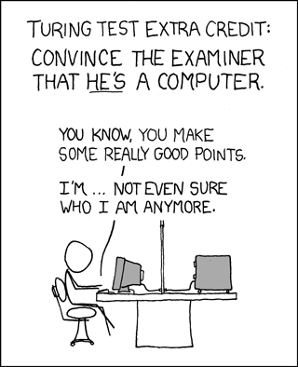

Slide 6
Notes:
From https://www.isc.org/solutions/survey/history

Slide 7


Slide 8
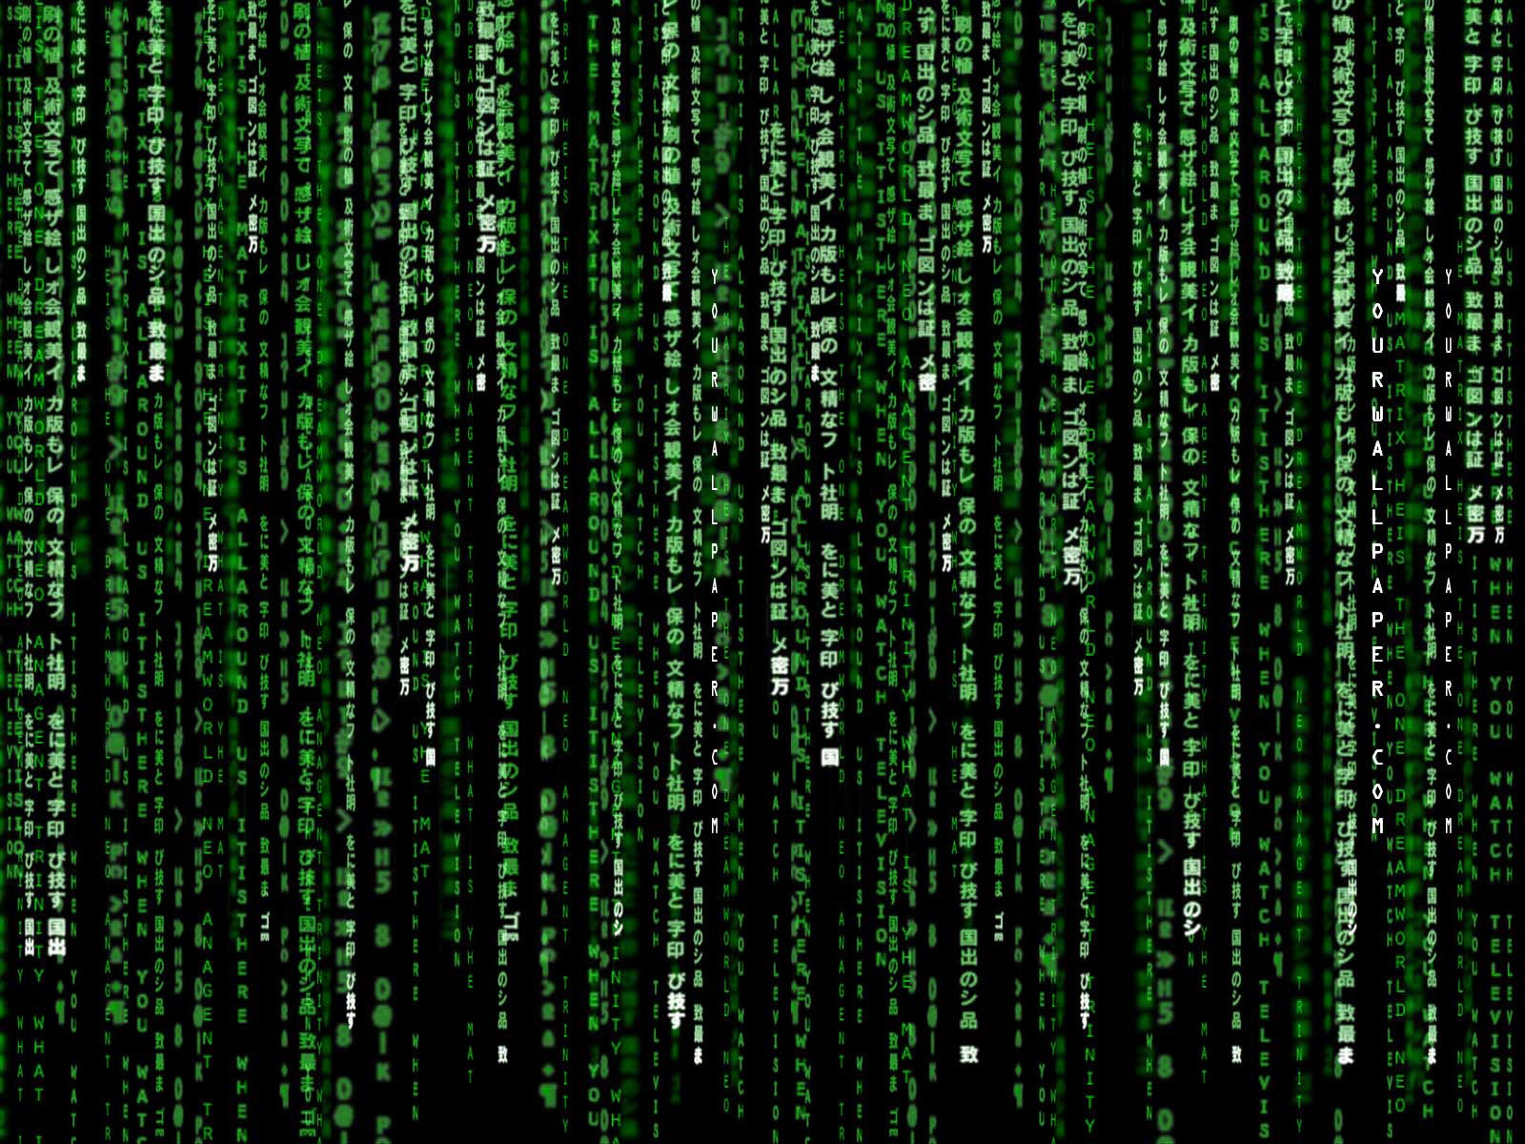
The Matrix is Everywhere
Student | Class 1 | Class 2
Student 1 | 3.4 | 4.0
Student 2 | 3.0 | 2.2
Student 3 (new) | 3.2 | 3.6
(Compute the distance between each row)
Student | Class 1 | Class 2 | Class 3 | Age
Joe | 3.3 | 2.1 | 3.0 | 18
Jim | 2.0 | 3.2 | 3.7 | 21
Suzy | 3.9 | 3.6 | 2.2 | 29
Jane | 1.9 | 3.5 | 4.0 | 17
Bob | 4.0 | 1.9 | 3.3 | 19
Amanda | 2.2 | 4.0 | 3.2 | 20
Notes:
Matrix math
Word similarity
Classes are like each other
Students like each class

Slide 9
Server | Median CPU Load | Median RAM Used | Median IOPS | Variation
Server A | 20% | 8GB | 100K | 4%
Server B | 2% | 20GB | 2M | 50%
Server C | 90% | 4GB | 100 | 5%
Server D | 10% | 15GB | 4M | 8%

Slide 10

You Can Do Math
Sum()
Notes:
Message:
Story To Tell:
Math isn’t hard
Writing code is math. Just another set of semantics.
SUM() is the same as E[]
Bayes Law P (B | A) = P(A | B) X P(B) / P(A) Example: This works for your spam filter

Slide 11
Clustering
Notes:
Message:
Story To Tell:
Clustering
Unsupervised learning
Demo (k-means)
http://thinkdatavis.com/portfolio/k-means.html
Create the centers from the data. Then let’s say you find another user, Joe, who fits into <>.
Treat them the same way. This is how you build a simple recommendation system.
Also called ‘collaborative filtering’. All of the previous users/behaviors subtly adjust future behavior.
…however, when you see an user, or a query, that sits on (boundary line)…where do they belong?
This is one of the big challenges of ML, entity disambiguation
<transition>

Slide 12
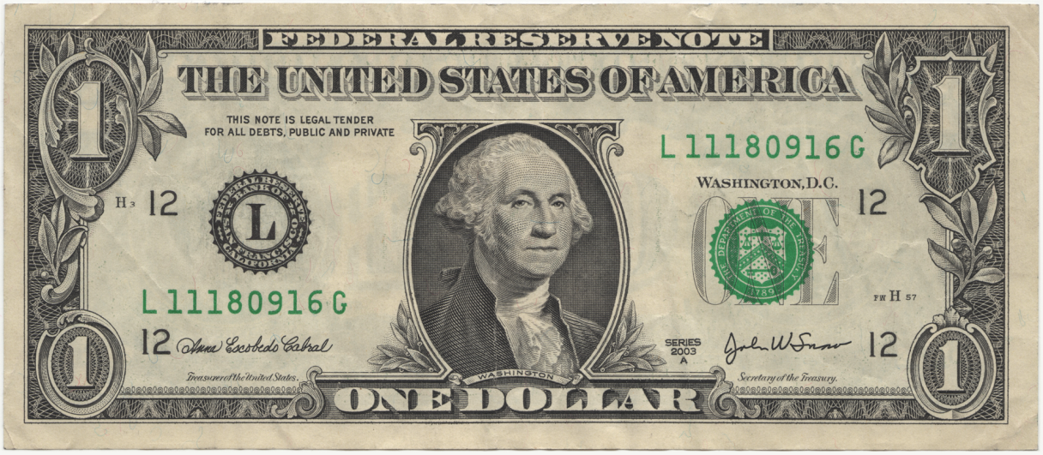

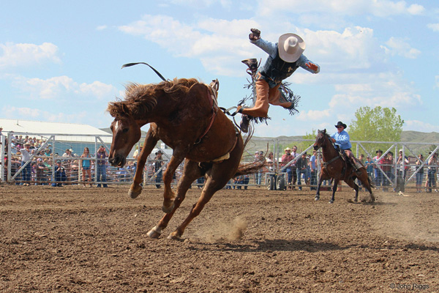
Entity Disambiguation

Slide 13
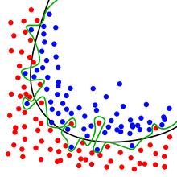
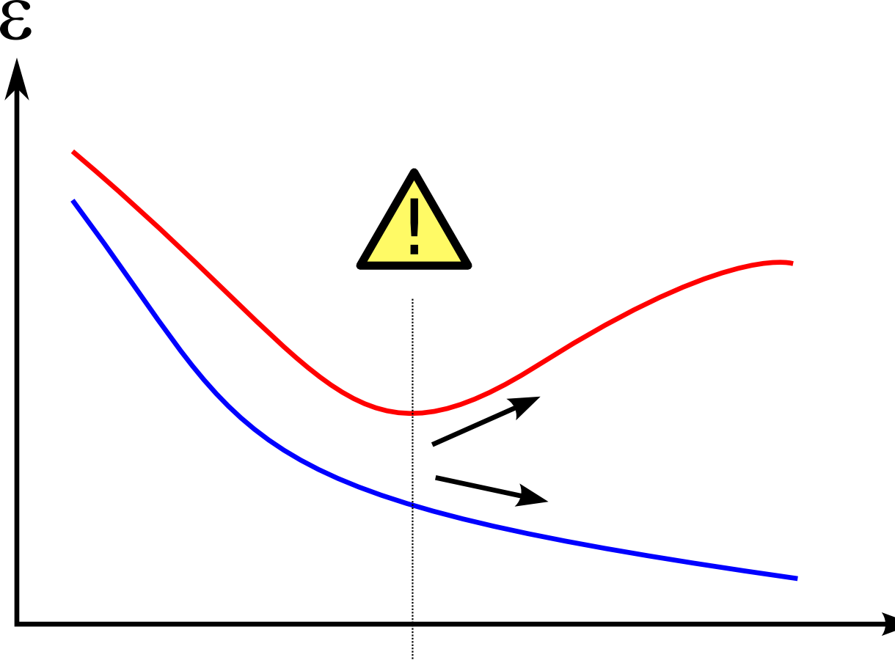
Overfitting: the ego’s tale
Notes:
Message: The goal isn’t to predict the past, it’s to predict the future. The future doesn’t look exactly like the past.
Story To Tell:
ML algorithms use what has happened in the past to predict the future. This assumes the future looks like the past.
People forget that. The past is built on assumptions, which may not always be true.
When you have an algorithm fit a data set too well, it becomes too specialized. “Losing the forest for the trees”
The other thing that happens is the amount of error when predicting the future goes up.
This is one of the big problems with machine learning, and one of the big reasons it’s hard to automate. Finding that line requires good judgment.
Luckily, there’s one common technique used to deal with this problem.

Slide 14

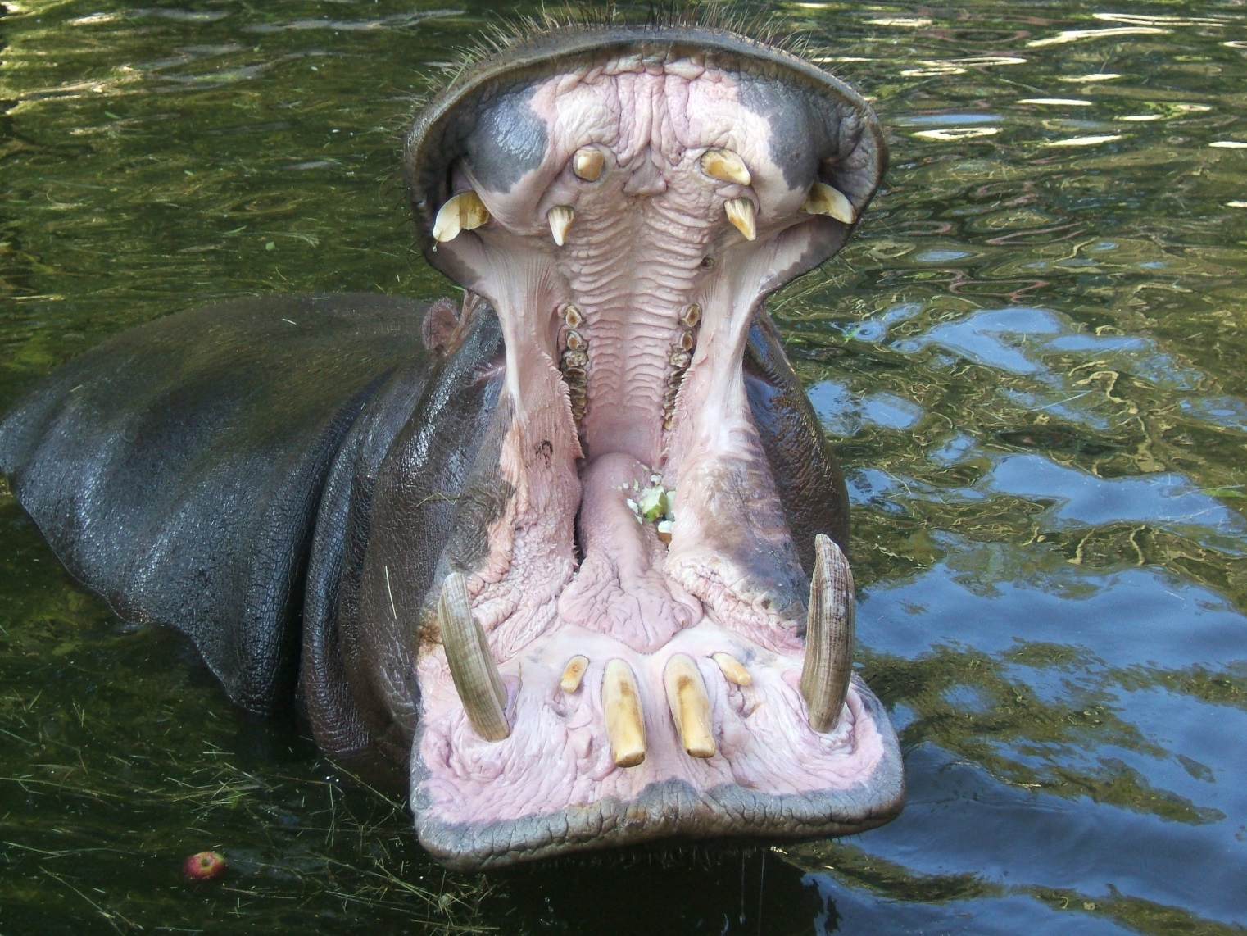
Ensembling
The HiPPO isn’t always right
A collective opinion can be more accurate.
Notes:
Message: It’s easy to place too much weight on a single person’s opinion. Groups of algorithms are stronger than single ones.
Story To Tell:
Predicting the future is important. Anyone who can do it well is immediately popular by all businesses.
Come up with an algorithm
Come up with a second
Average the results.
See if it’s better.
Repeat
However, you still need to know how much weight to give to each algorithm, play with the results, see where the combinations are stronger or weaker.

Slide 15
Signal / Noise
Notes:
Message: Machine learning is changing so quickly, and there’s so much hype, that the real lessons can be lost in the noise
Story To Tell:
Know math.
Use cross-validation
Curiosity is the best trait to cultivate
It’s fine to code first and think of math second. Just do both
Ask crazy questions of your data
The ML community is just as active as the SQL community. They’re just different people.
Use online sources (Strata, Twitter, blogs by experts) to learn
The most common ML techniques are decision trees, k-means clustering, and linear/logistic regression.
Know when you’ve won
Automating this process is NP hard. It’s computationally impossible to try all techniques and variations and ‘automagically’ get th right answer.
Because it’s changing so fast, personal traits can make up for experience, because experience is outdated so quickly
Curiosity
Knowledge of your own biases
Persistence

Slide 16
Resources
http://devnambi.com/data-science/
http://github.com/DevNambi
Notes:
Resources

Slide 17
Q&A
Notes:
Q&A

